Slide 1


Optimizing Parallel Recursive Datalog Evaluation on Multicore Machines
Jiacheng Wu (University of Washington)
Jin Wang (Megagon Labs)
Carlo Zaniolo (University of California, Los Angeles)

Slide 2
Datalog
Naturally support recursive queries
Succinct program structure
Program: a collection of rules
Rule: interpret in logic implication
Has been applied into various Big Data analysis applications:
Networking, knowledge base, social network, graph search etc.

Slide 3
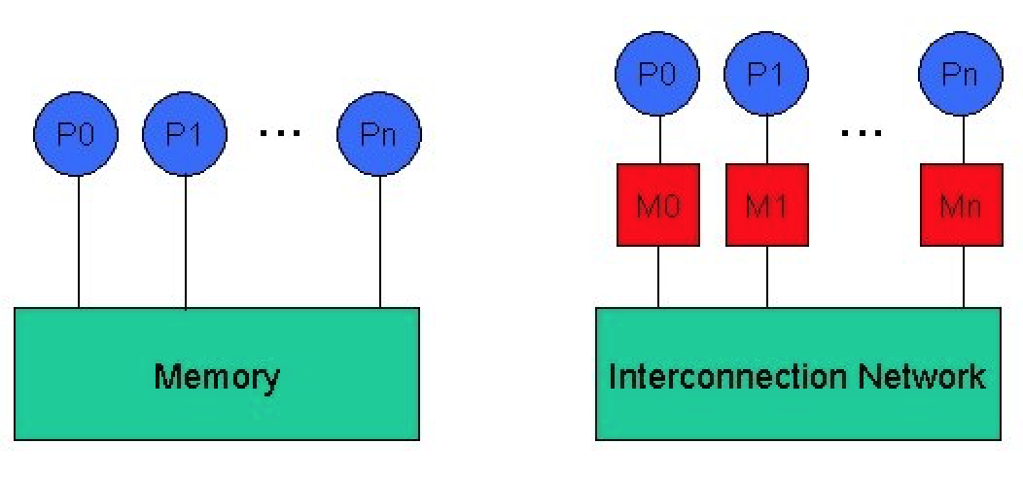
Background
We focus on parallel Datalog evaluation on shared-memory multicore machines.
Potential Overhead:
Computation time
Coordination
Disk I/O
Network I/O
✔
✔
✘
✘
Shared Memory
Shared Nothing

Slide 4
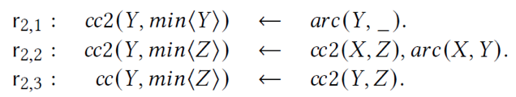
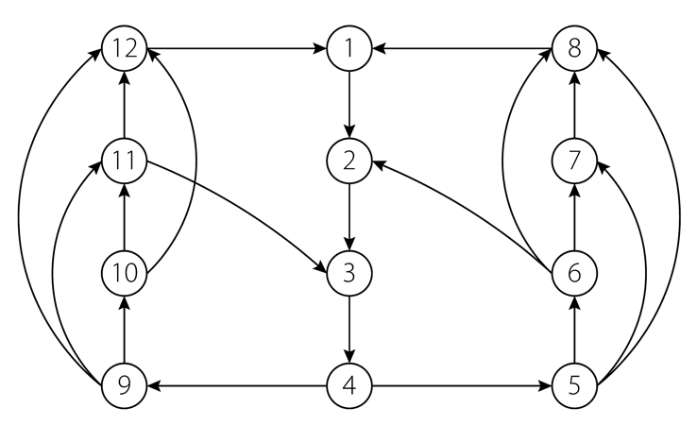
Example: Connected Component (CC)
Basic Steps:
Partitions
Repeat the process until global fixpoint is reached
Run local iteration in parallel until the local fixpoint is reached
When every worker reaches local fixpoint, conduct coordination between workers
All workers proceed to the next global iteration

Slide 5
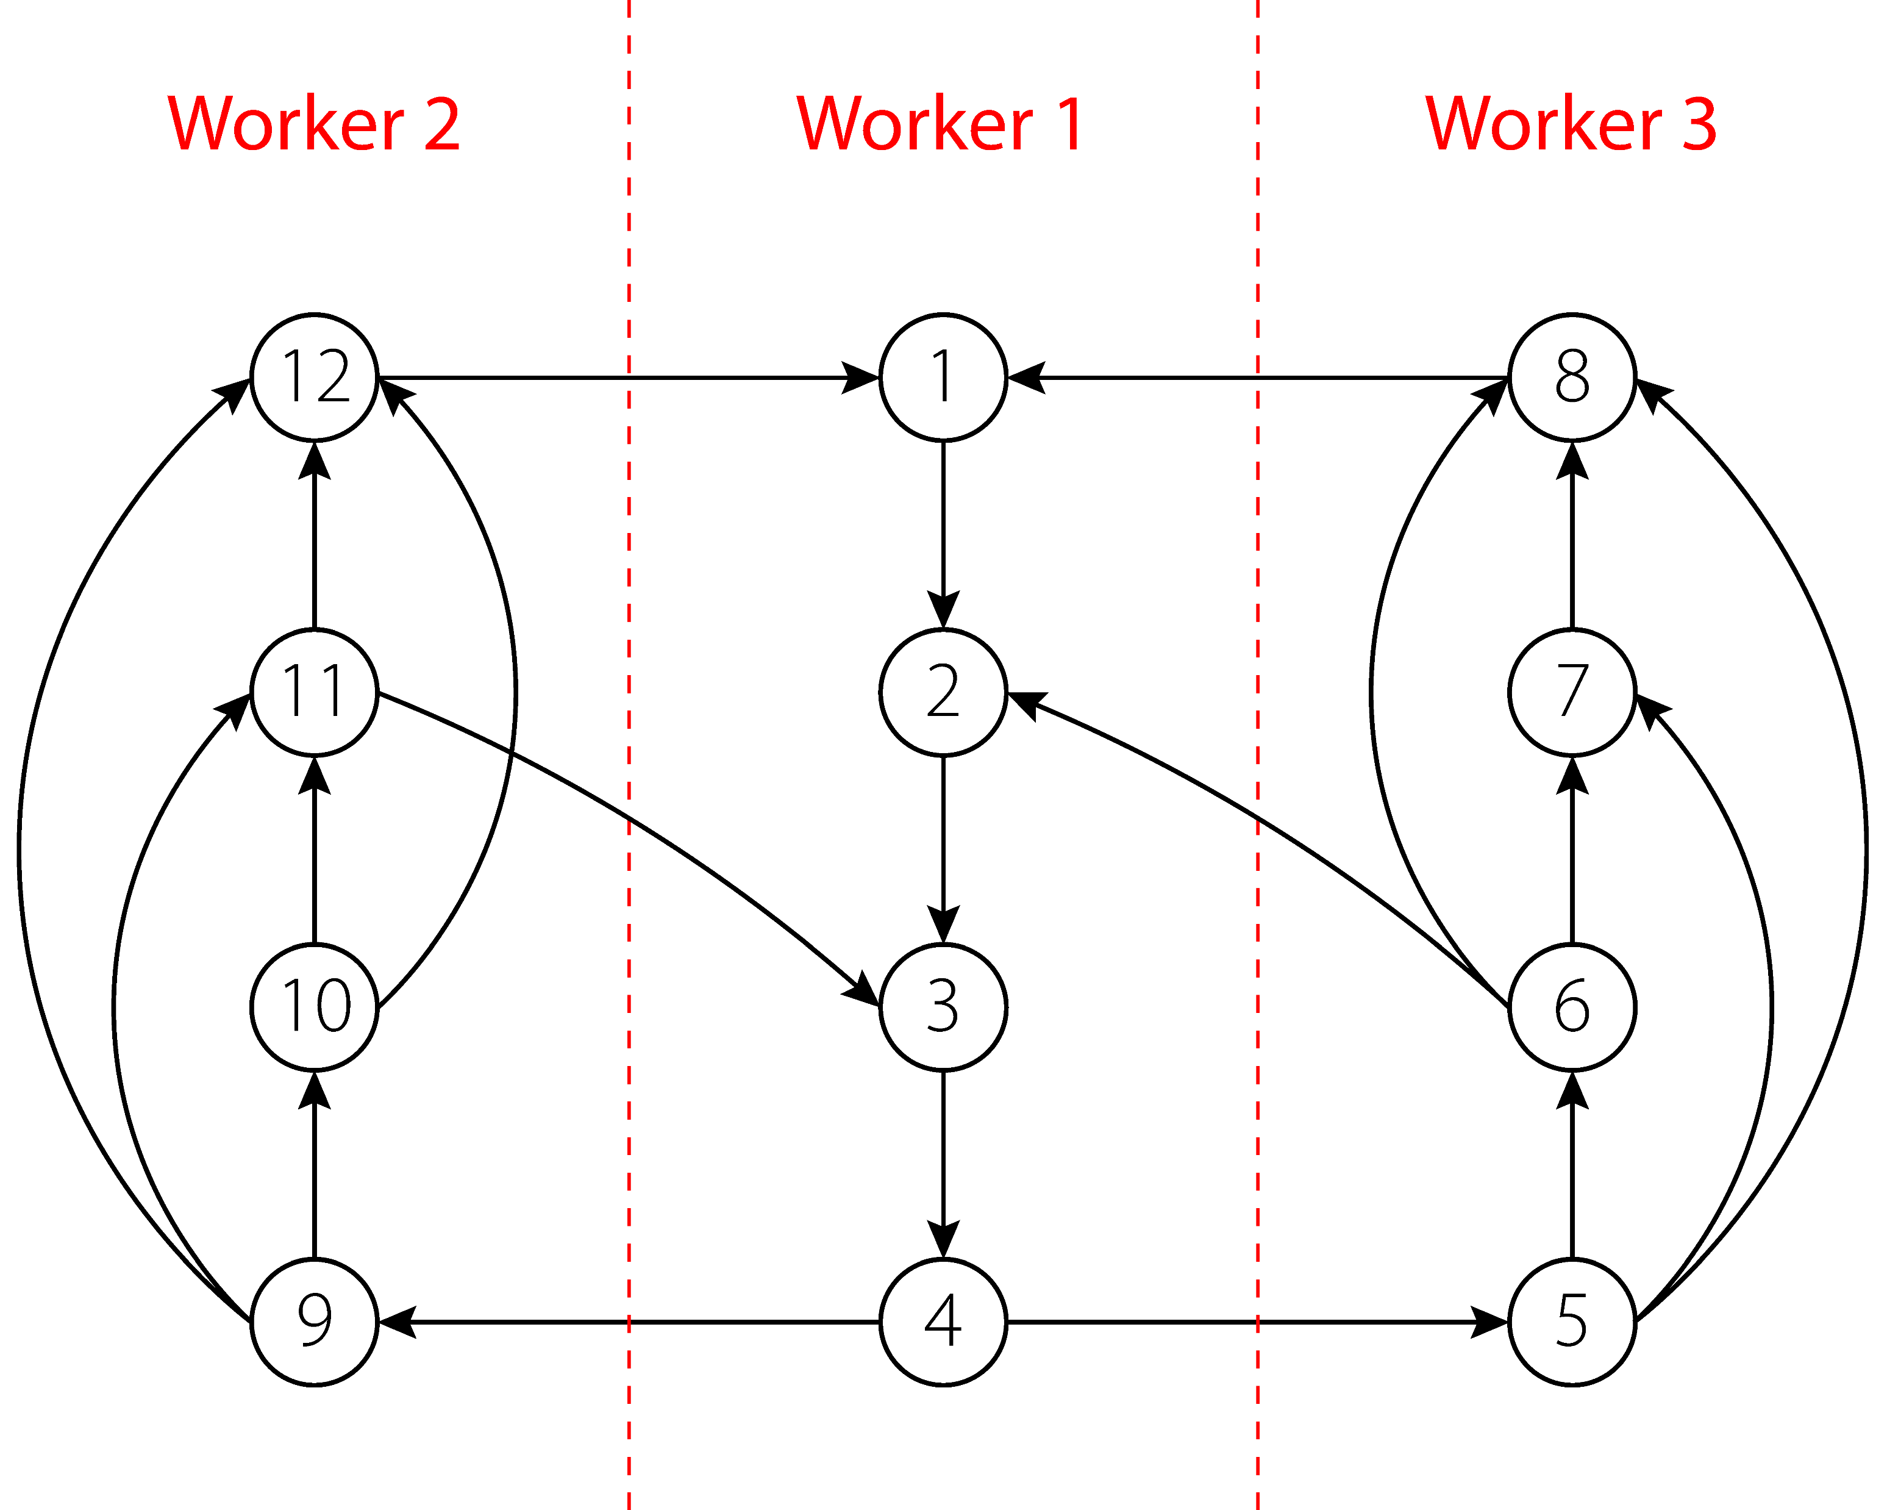
CC – Partition

Slide 6
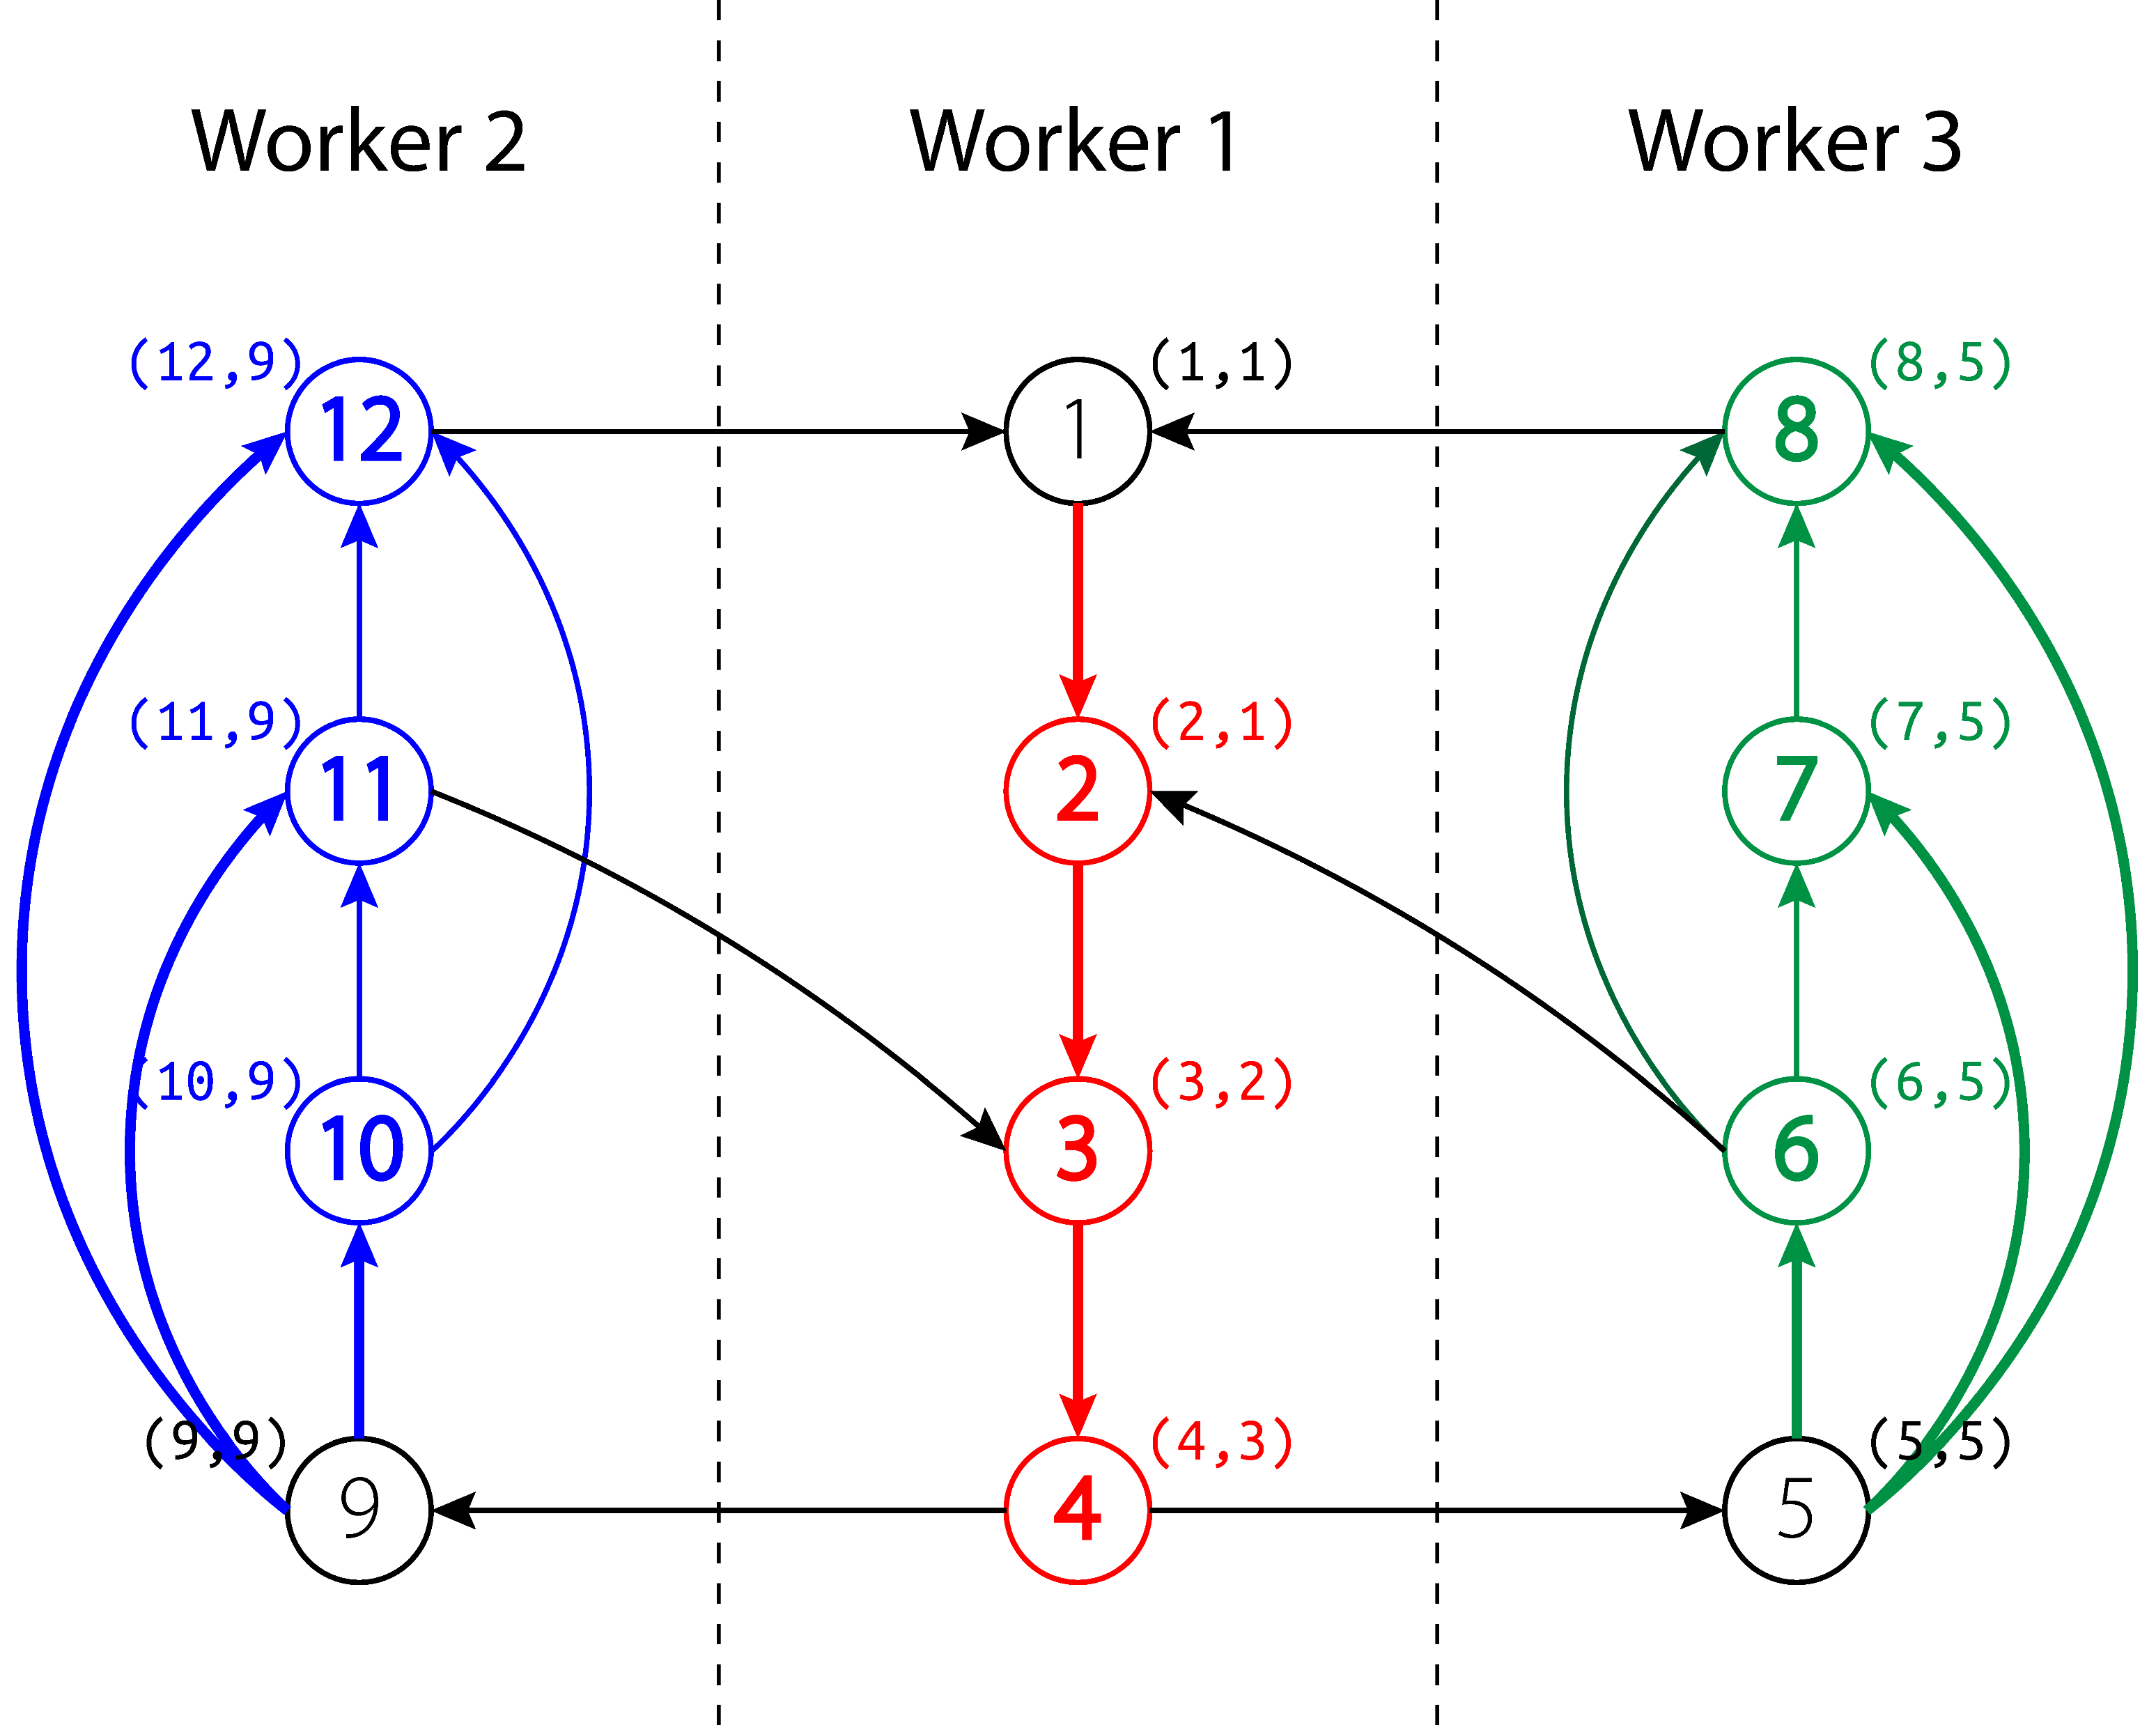
CC – Local Iteration

Slide 7
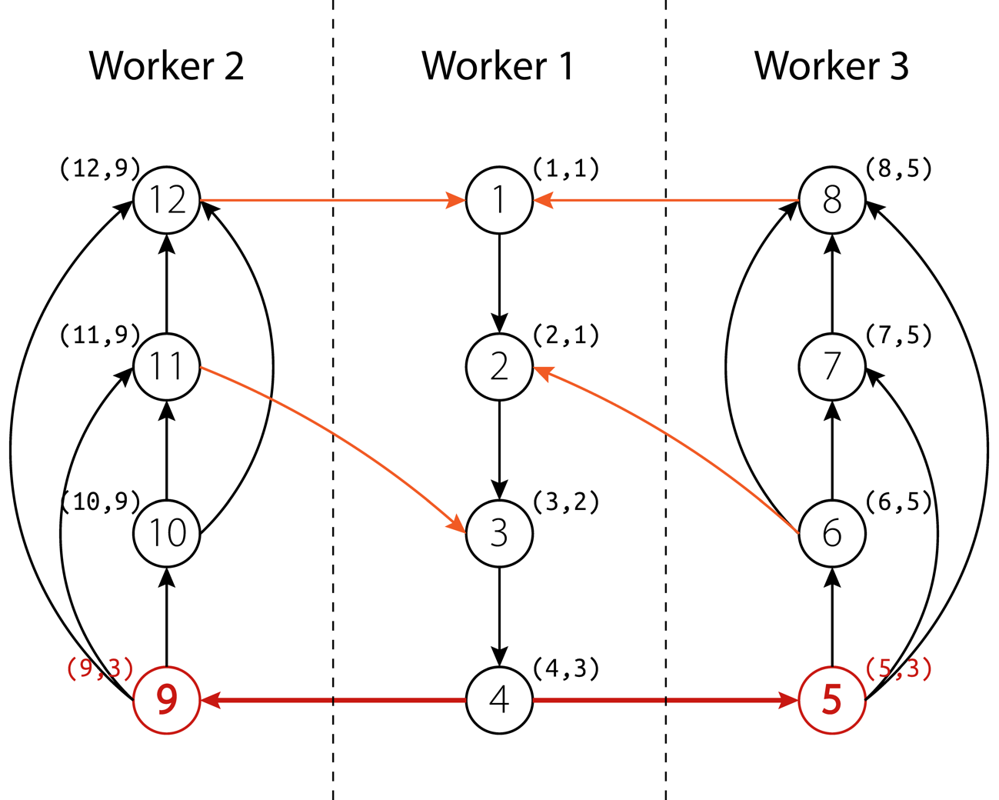
CC – Coordination

Slide 8
Challenges
Bottleneck: coordination between workers
Performance issues are caused due to:
Coordination happens after each global iteration
Faster workers are blocked after each local iteration
Parallel Query Planning

Slide 9
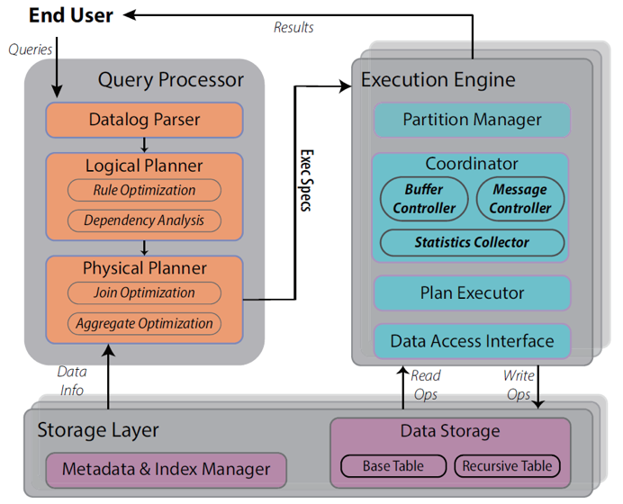
Contribution Overview
New Coordination Strategy
✘remove the barriers caused by global iteration
✔ allow a worker to proceed locally
Dynamic Coordinate Datalog
Efficient Coordination
Query processing techniques

Slide 10
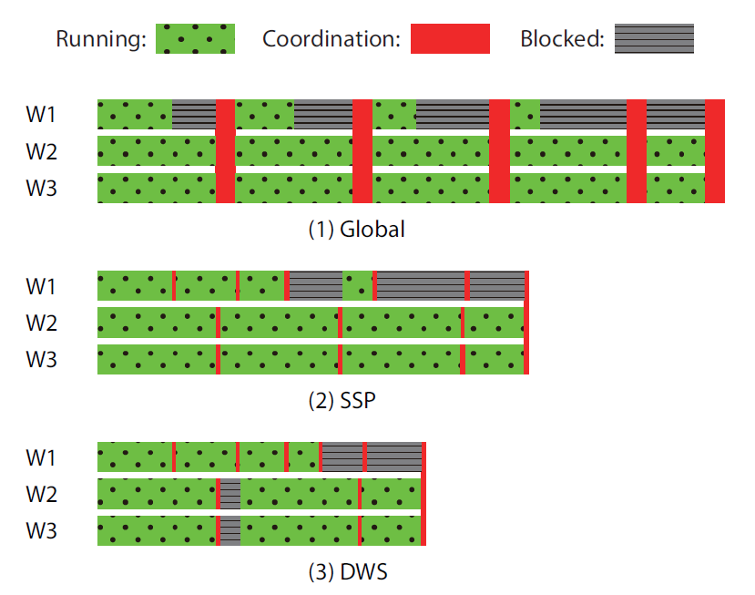
Naïve method: Global
Limitations:
Idle waiting happens before coordination (Blocked)
Coordination might result in serious race conditions

Slide 11
Mechanisms – SSP (Stale-Synchronous Parallel) [Ho et al. 2013]
Core Idea
all workers continue executing at most 𝑠 local iterations before stopping to wait for slowest one
Intuition
Workers spend more time performing actual computation

Slide 12
Mechanisms – DWS
DWS (Dynamic Weight-based Strategy)
Eliminate global coordination
Each worker decides whether to proceed to next local iteration all by itself
Maintain a set of parameters to facilitate decision making

Slide 13
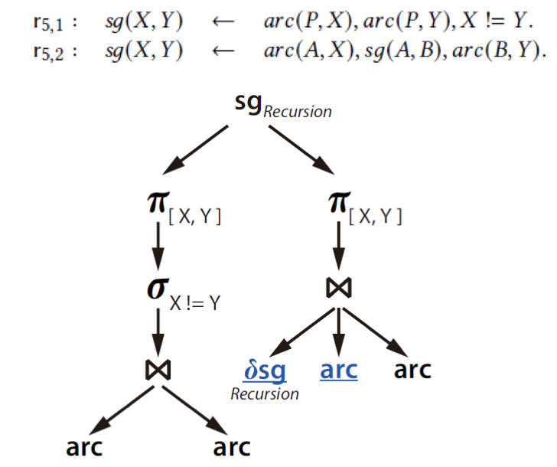
Plan – Logical
Query: Same Generation
Logical Plan
From AND/OR Tree
Use DAG to denote query plan
Mark Recursive Table
Change to Delta for SN
Greedy Optimization
Push down selection operator
Reorder recursive tables to leftmost in join body

Slide 14
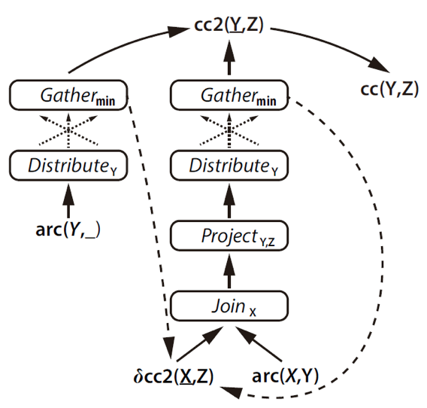
Plan – Physical
Physical Plan
Run in each worker
Manage coordination
Physical Operator
Join
Gather
Collect tuples from other worker
Distribute
Allocate tuples to other workers

Slide 15
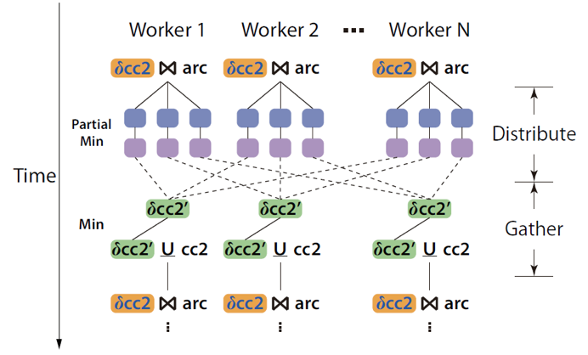
Optimizations
Aggregates in Recursion
Compute partial aggregate first
Merge them to existing results
Make use of indexes
Existence Checking
Use additional cache structure
Check whether a key exists in table/index
Distribute: keep the minimum Z for each Y
Gather: update index if new tuples has smaller Z

Slide 16
Experiment: Setup
Benchmark program
Same Generation, Delivery
Connected Component, Single Source Shortest Path, Page Rank
Datasets
Real world dataset
LiveJournal, Orkut, Arabic, Twitter
Synthetic dataset
Tree-11, G-10K, RMAT-N, N-n
Baselines
SociaLite, DeALS-MC, Ddlog, Souffle, RecStep

Slide 17
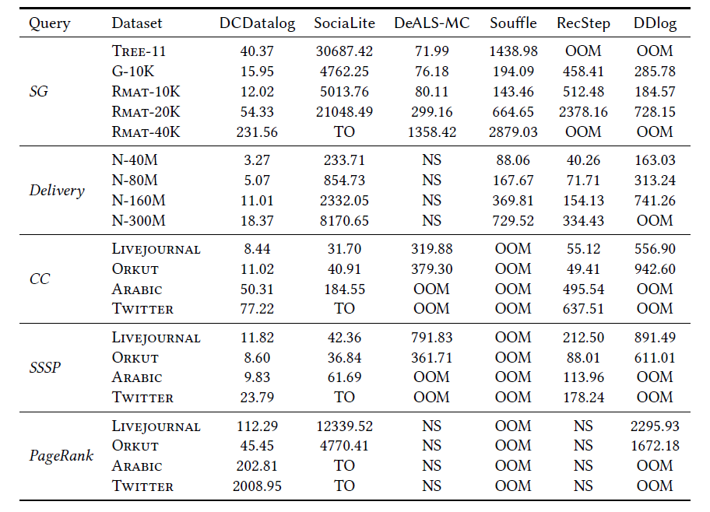
Main Results (seconds)
TO: timeout (> 10 hours)
NS: not supported
OOM: out of memory
achieves 3 ~100 times performance gain
aggregate in recursion
Alleviate race condition
reduce idle-wait
…

Slide 18
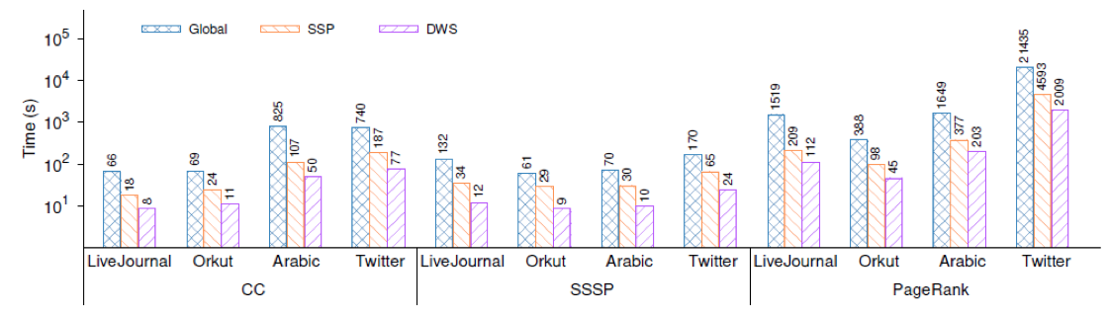
Effect of Coordination Methods
Comparisons between Global, SSP and DWS
DWS achieves the best performance under all settings.

Slide 19
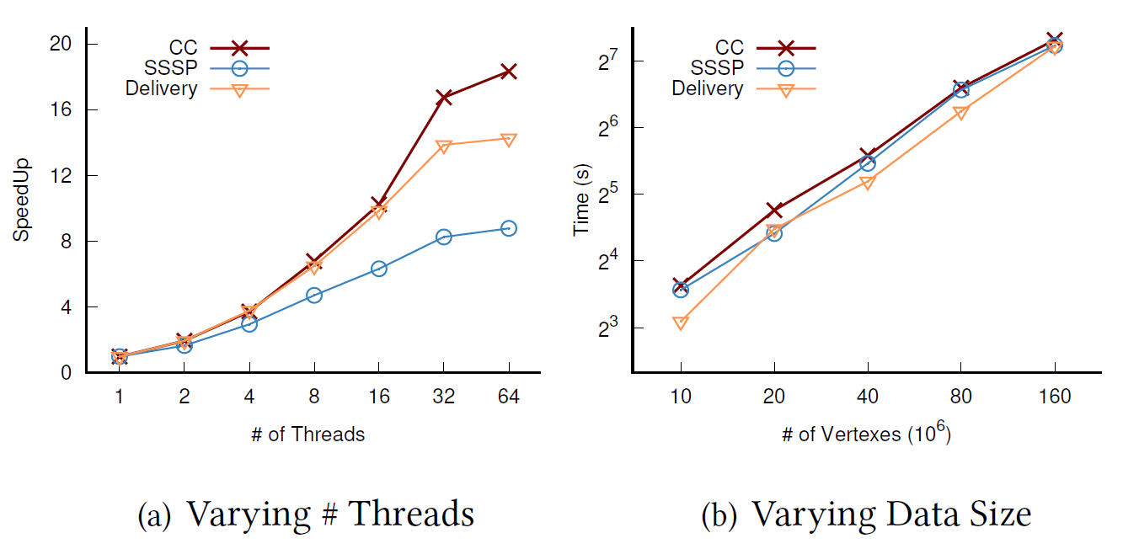
Evaluations – Scalability
DCDatalog performs well for both scale-up and scale-out cases

Slide 20
Conclusion
DCDatalog -- A parallel Datalog engine for shared-memory multicore architectures
A novel dynamic coordination strategy to overcome existing limitations
Query planning and optimization techniques to improve performance
Achieve up to two order of magnitude performance gain

Slide 21
The code of DCDatalog is available at: https://github.com/Jiacheng-WU/DCDatalog
Thank You!

Slide 22
Mechanisms – Global
Previous Parallel SN evaluation
The key range (data) is split into disjoint partitions by hash functions H
All workers run in parallel, and each deal with its own assigned partition
A separate index is build for each partition of the base table (e.g., arc)
Each worker Wi become active and perform SN evaluation
Wi initialize its recursive table Ri from base rule and build B+Tree index on Ri
Wi perform local iteration of semi-naïve and generate the new delta relation 𝛿Ri
Wi wait all workers finish their iteration and then coordinate with other workers
Wi should exchange the newly generated tuples according to hash functions H
Wi need to update indexes and perform deduplication at the same time
Wi become inactive if 𝛿Ri is empty and become active if others send Wi new tuples.
Evaluation terminates when all workers become inactive (Fixpoint)
The final result is equal to the union of recursive tables on all workers

Slide 23
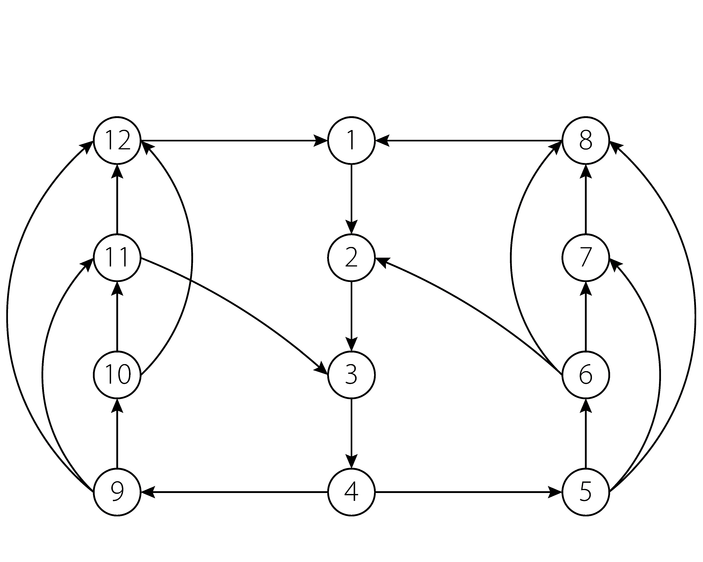
Global – Initialization

Slide 24
Global – Partition

Slide 25
Global – Local Iteration

Slide 26
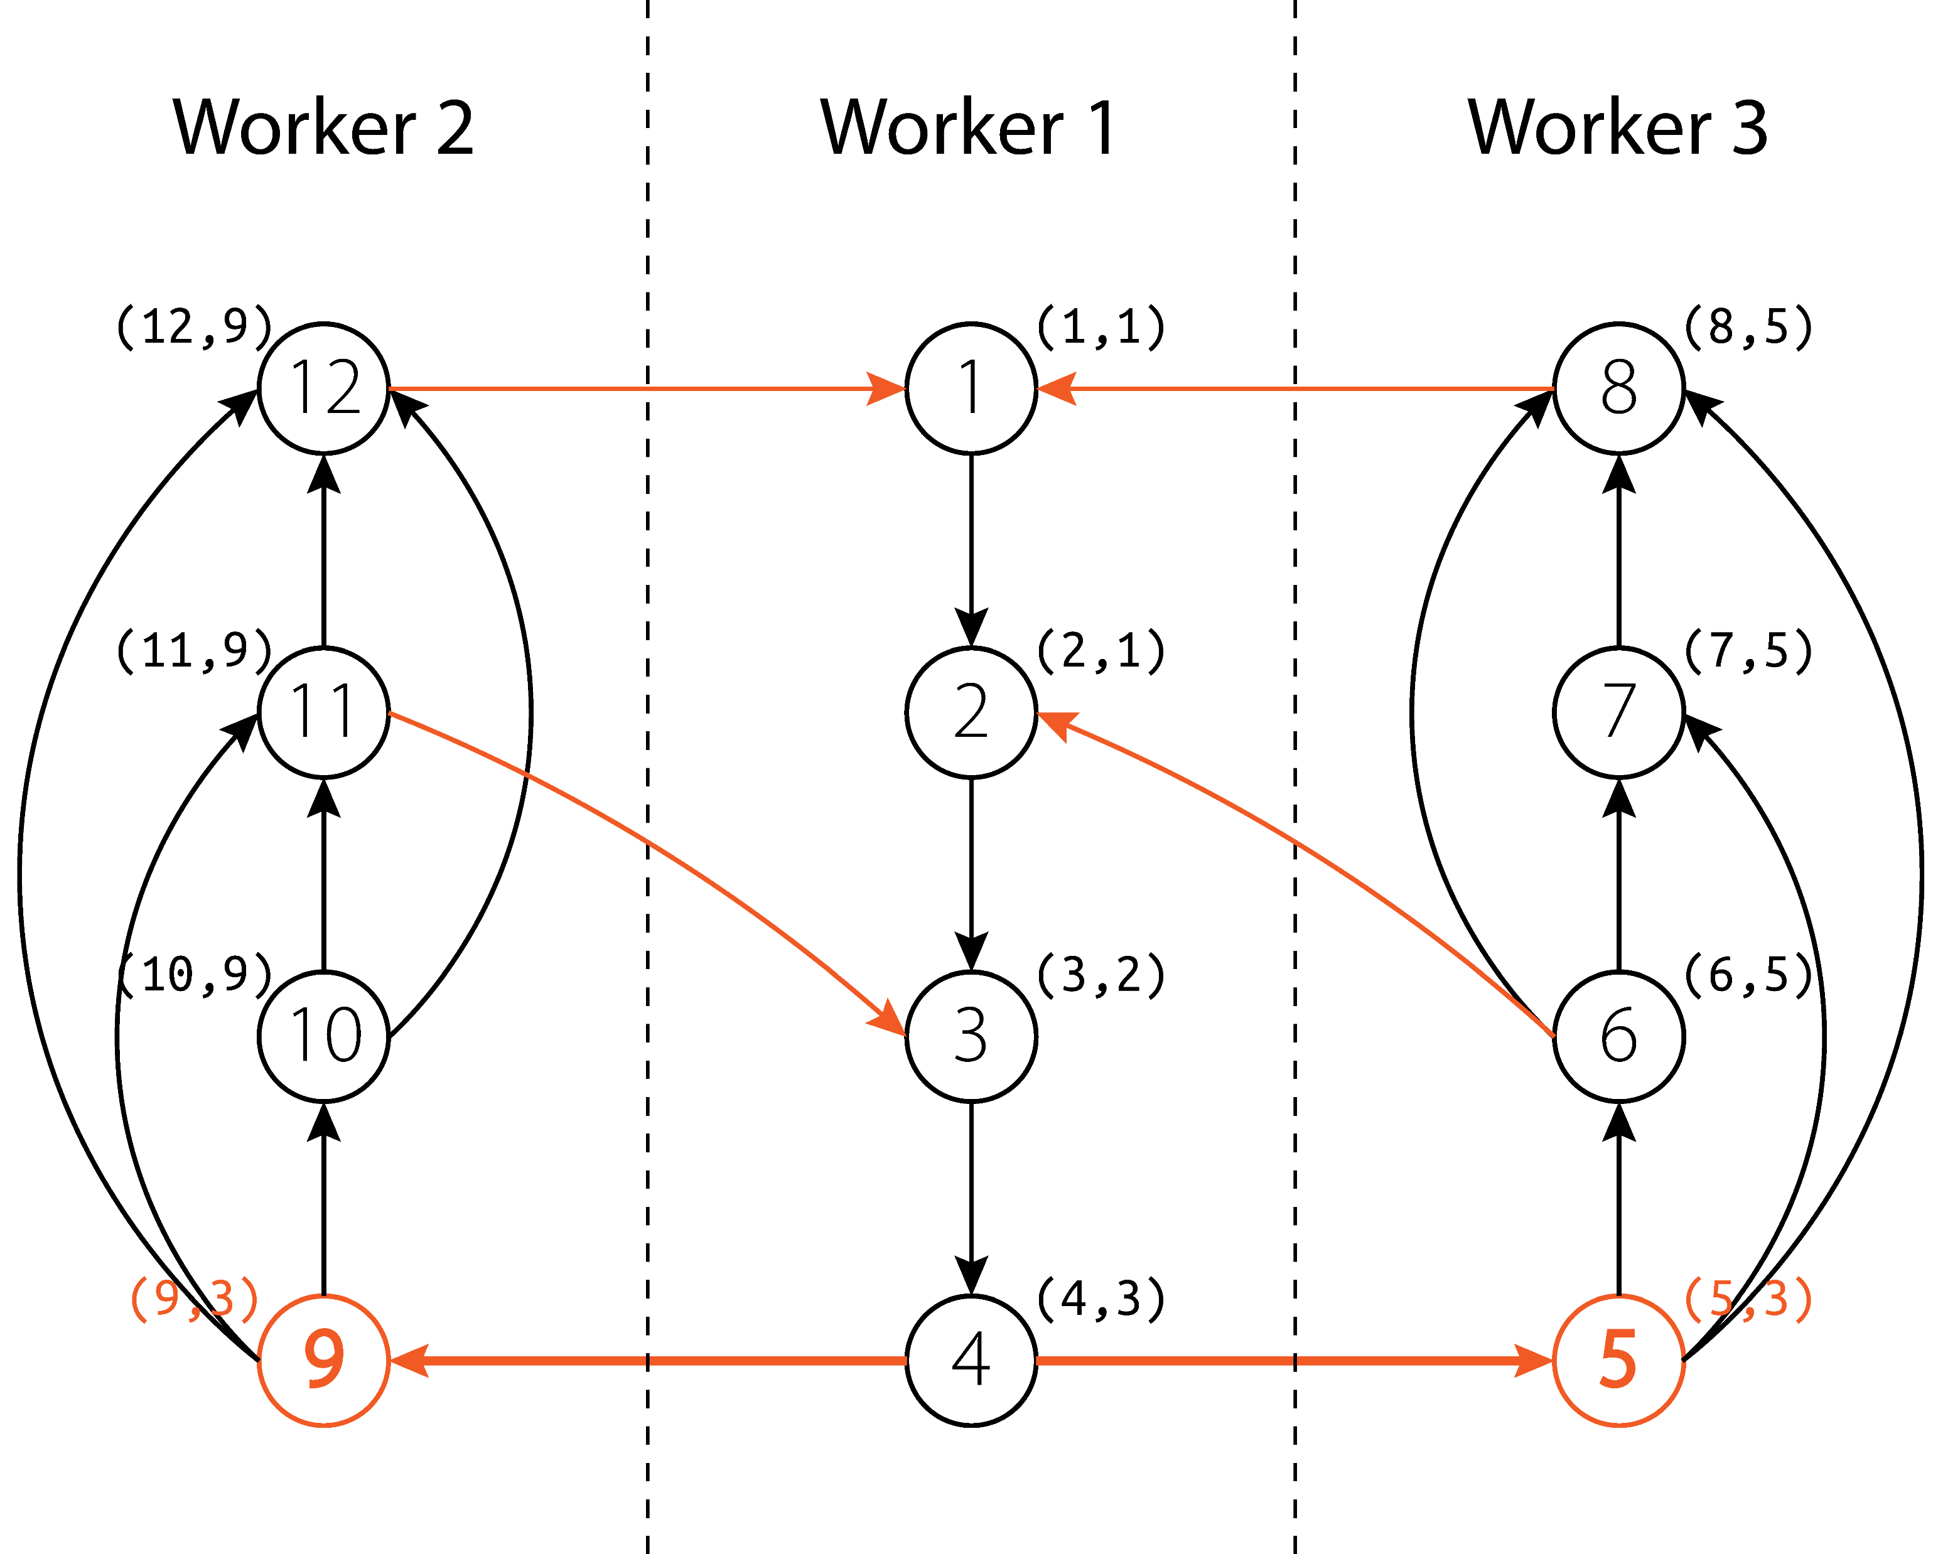
Global – Coordination

Slide 27
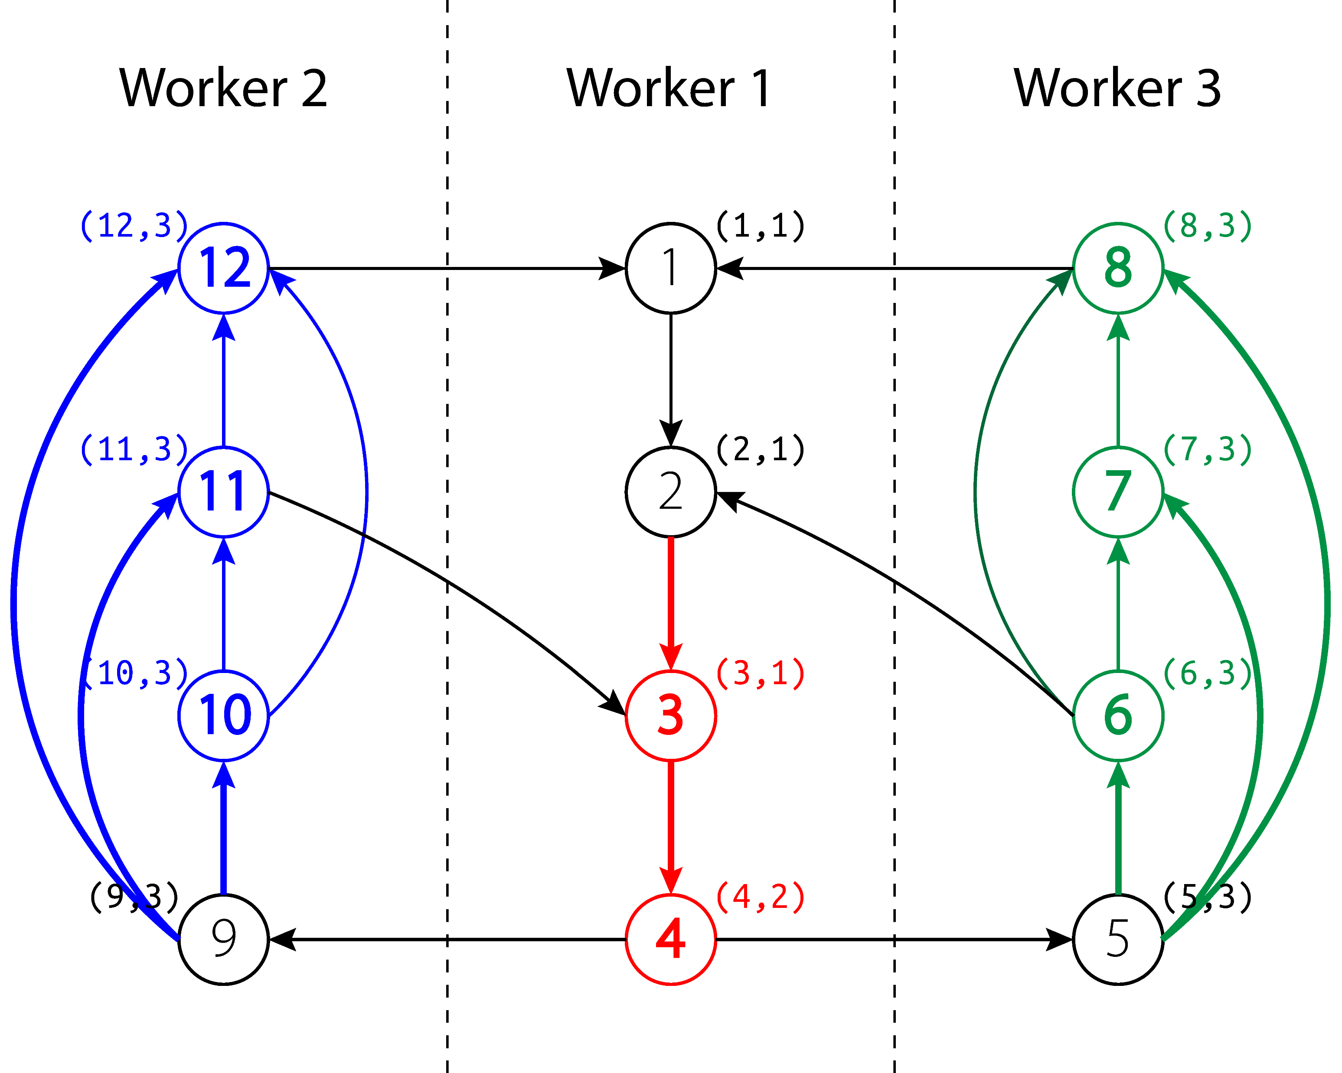
Global – Local Iteration

Slide 28

Global – Coordination

Slide 29

Global – Local Iteration

Slide 30
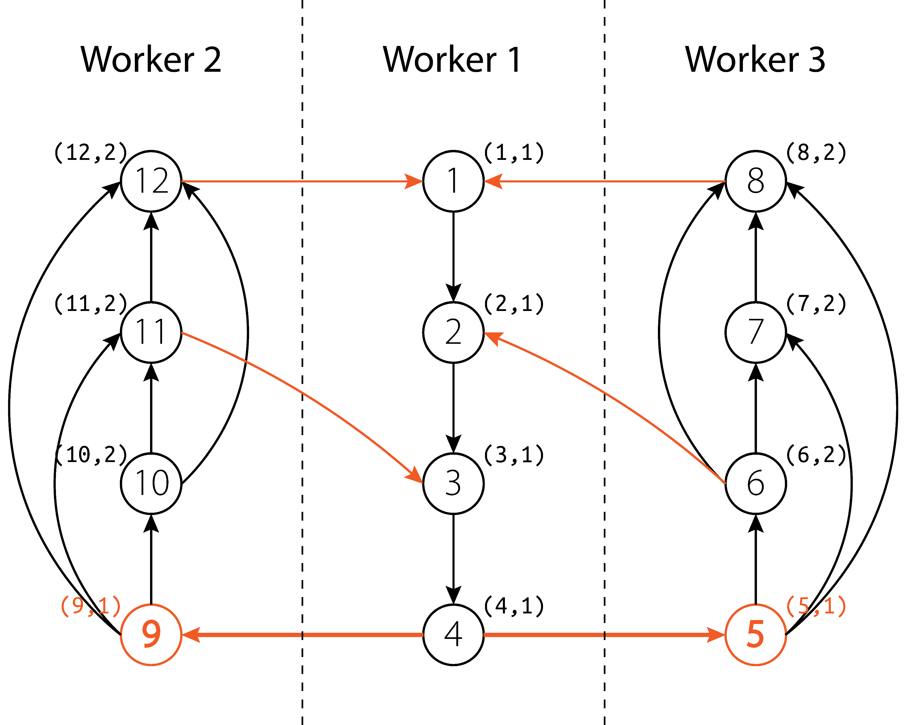
Global – Coordination

Slide 31
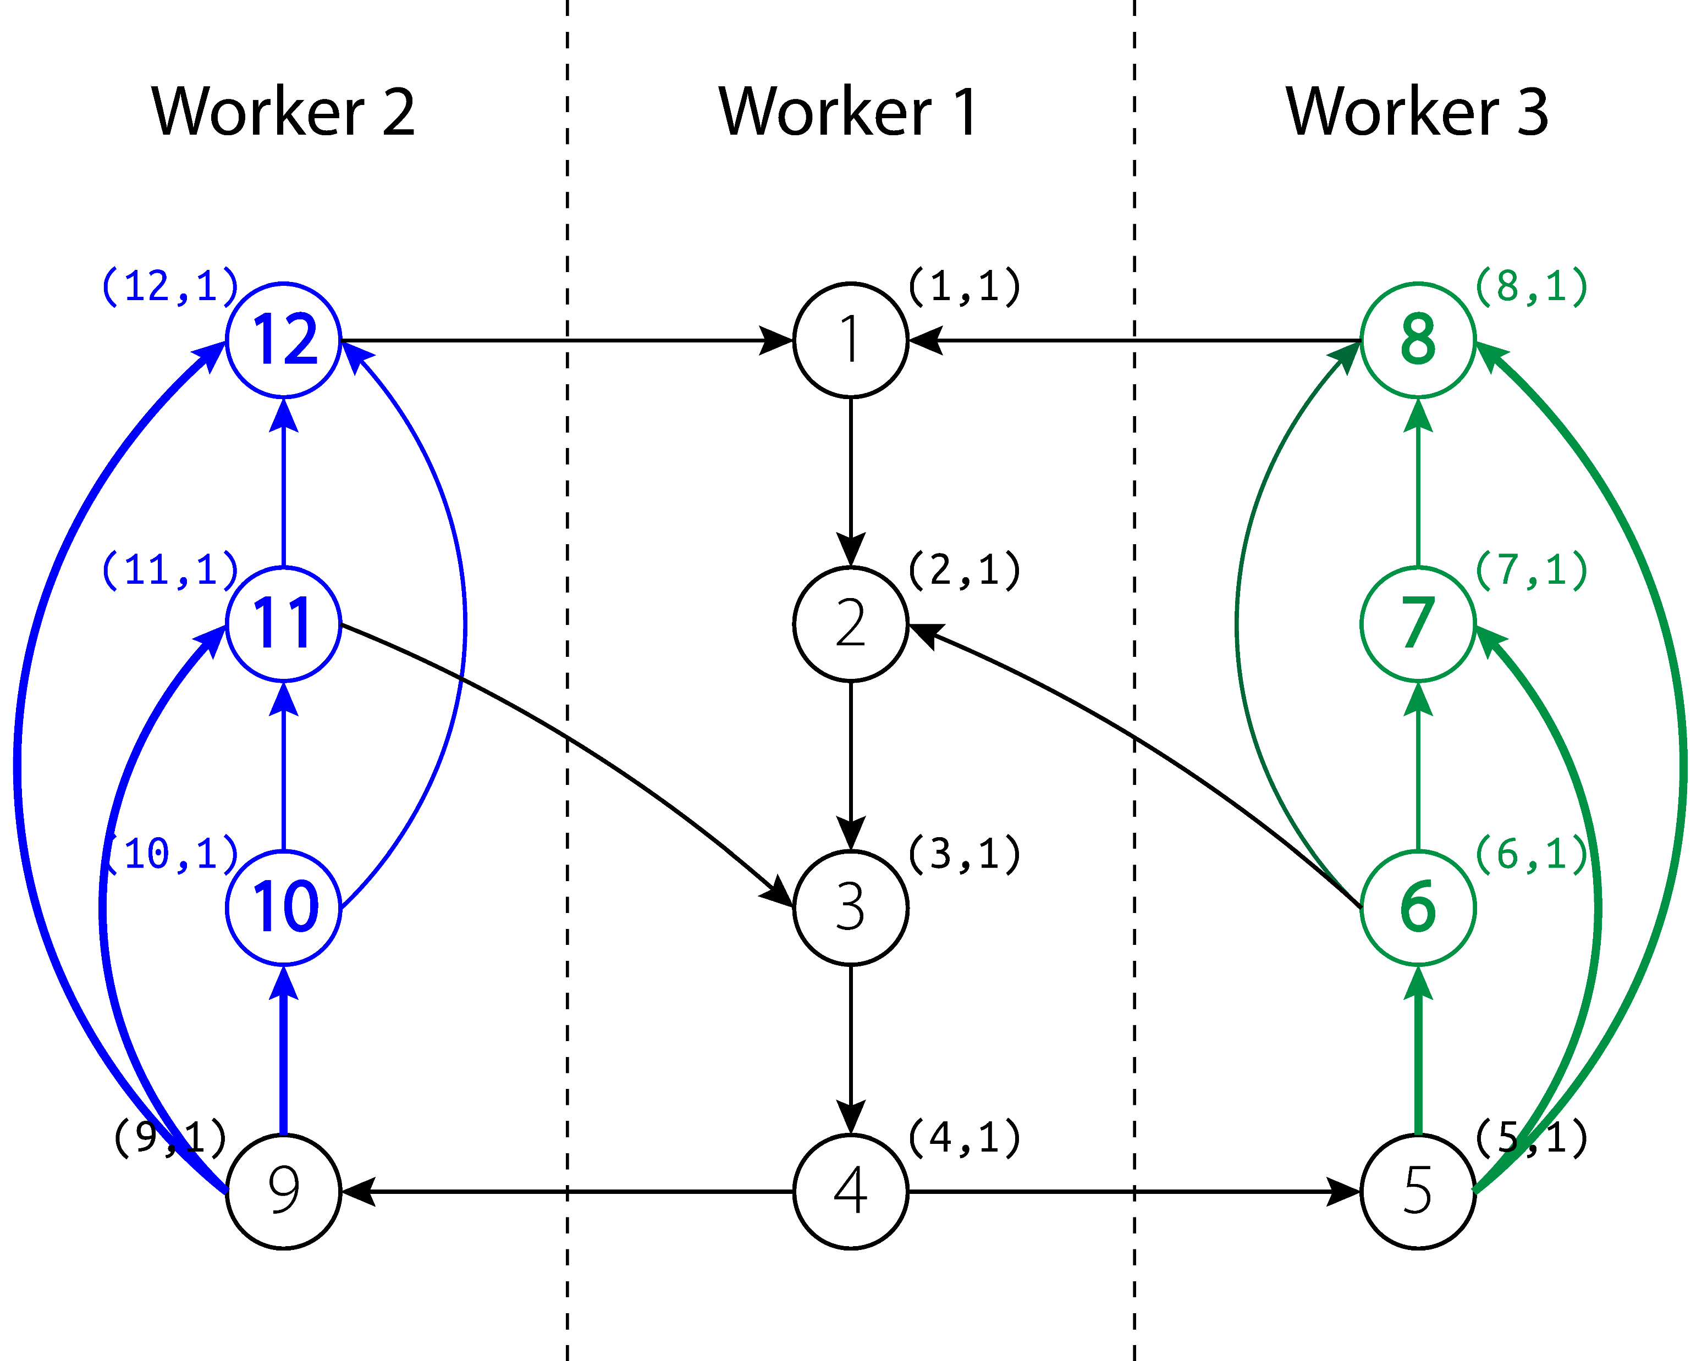
Global – Local Iteration

Slide 32
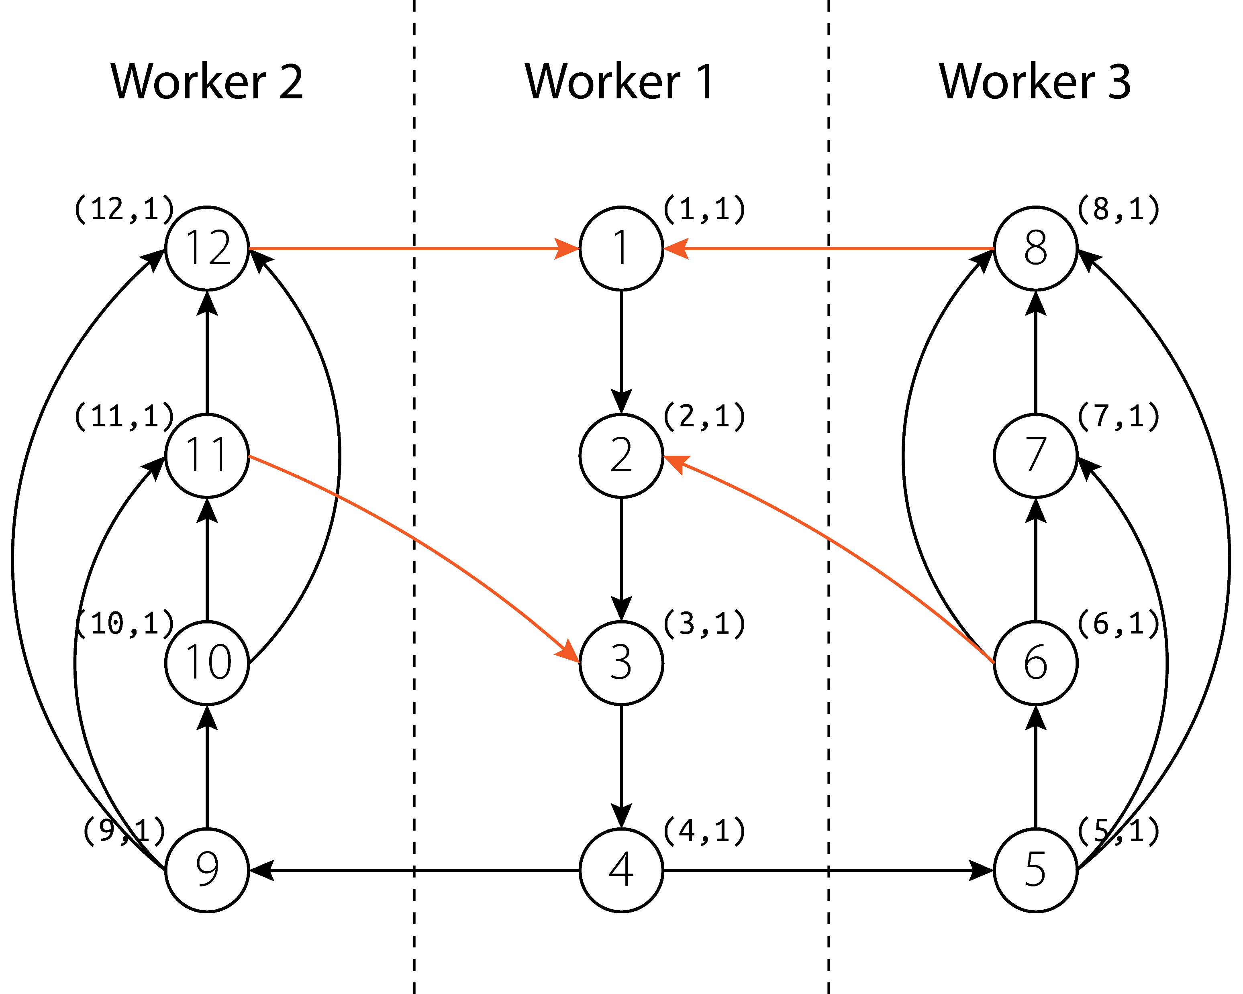
Global – Coordination

Slide 33
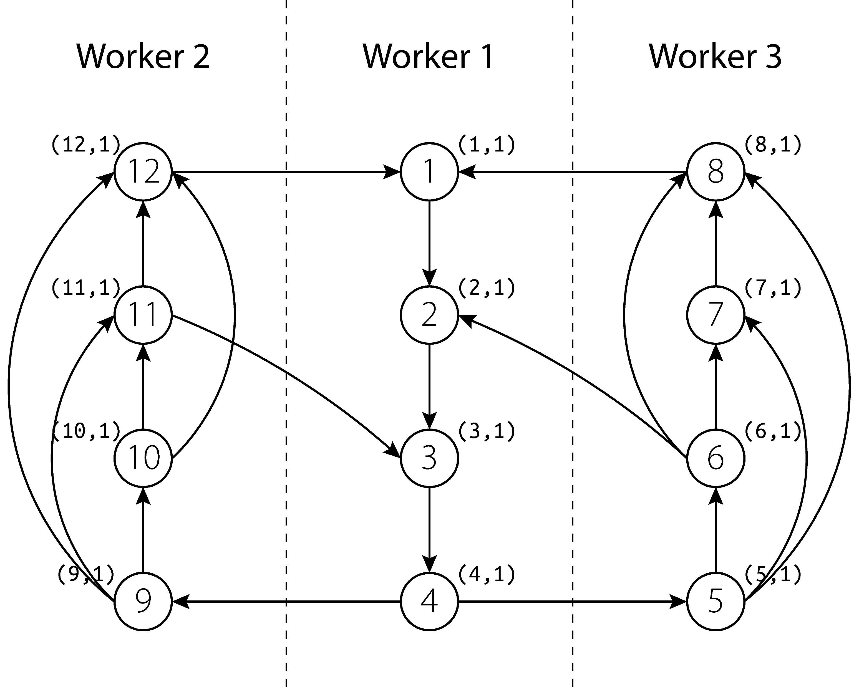
Global – Termination

Slide 34
Mechanisms – DWS
Parameters
𝜔𝑖 : threshold for the cardinality of delta table for Wi to continue next iter
𝜏𝑖 : the time Wi should wait before proceeding to the next iter
Use Queueing Theory to autotune the parameters 𝜔𝑖 and 𝜏𝑖
Coordination (Memory Buffer)
Each worker has a memory buffer to hold delta relation from other workers
The memory buffer is split to different areas for different other workers
Coordination can be achieved by allocating tuples to the buffer (async)
Race conditions are reduced and restricted in the memory buffer
Worst-Case Analysis
When a program reaches the fixpoint,
# iterations run in the slowest worker of DWS <= that of Global.

Slide 35
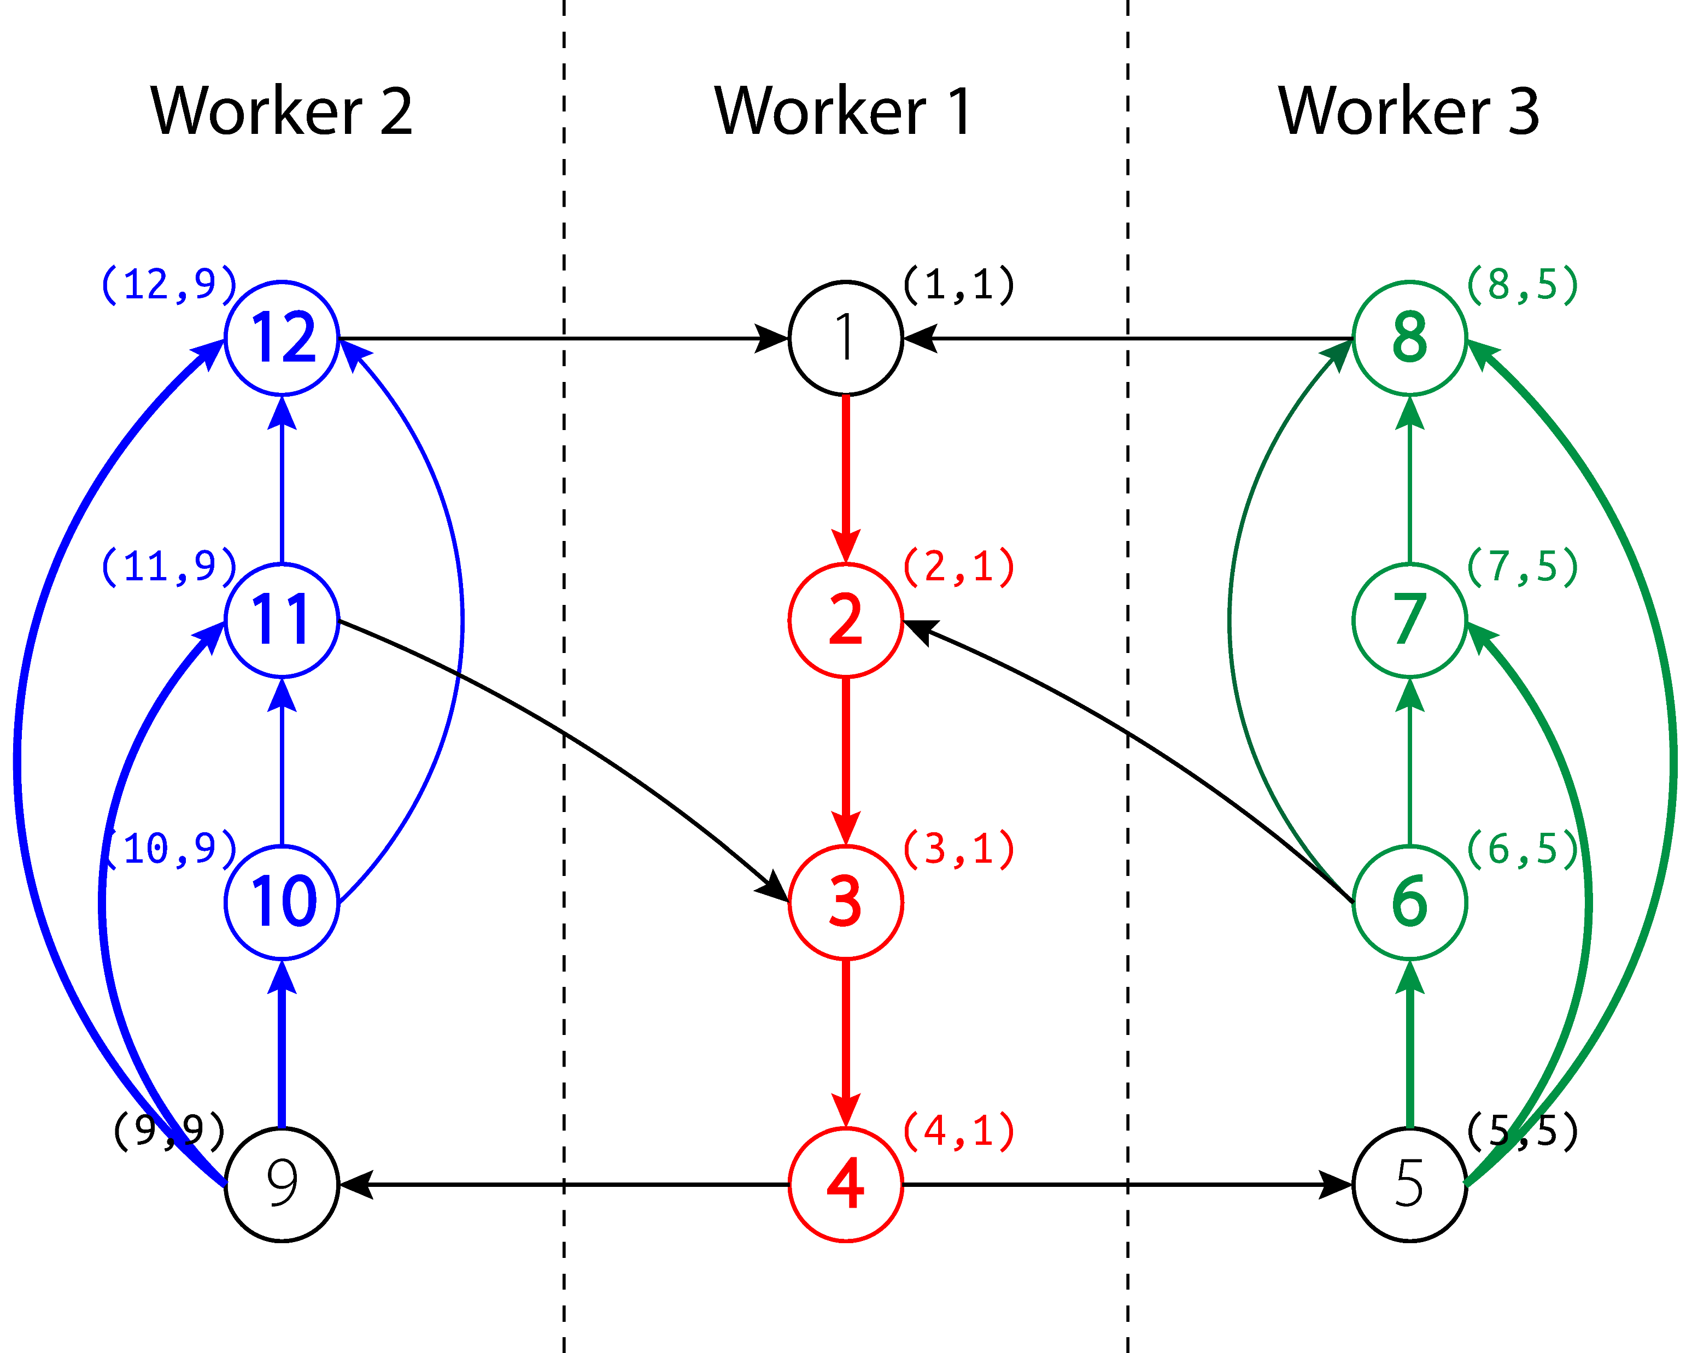
DWS

Slide 36

DWS

Slide 37
DWS

Slide 38
DWS – Termination

Slide 39
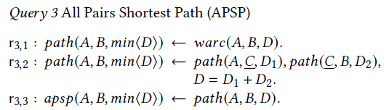
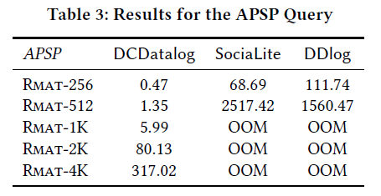
Discussions – Complex Queries
Non-Linear Recursion
In r3,2 body
Partition 1st path by 2nd attr C
Partition 2nd path by 1st attr C
Partition by Join Attributes!
Route (A, B, min<D>) and replicate it to H(A), H(B) partition
Worker collect two parts of path with same join keys and do join
At most twice the number of tuples in path are allocated

Slide 40
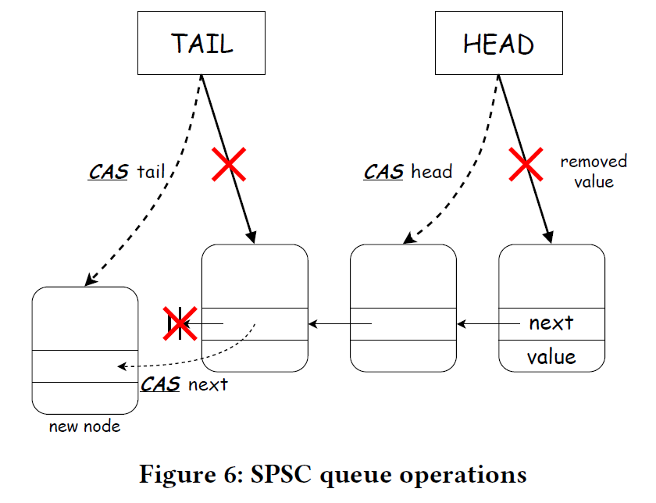
Implementation Details
During DWS evaluation
The race condition happens only between two workers
Worker A distributes info to B
Worker B collects info from A
SPSC lockfree queue is enough!
Check Global fixpoint
All workers are inactive
All queues are empty

